Slide 1

Vidyavardhini’s College of Engineering and Technology
Department of Electronics and Telecommunication engineering
Major Project topic:
Augmented Reality in Education: The Smart way of Learning

Slide 2
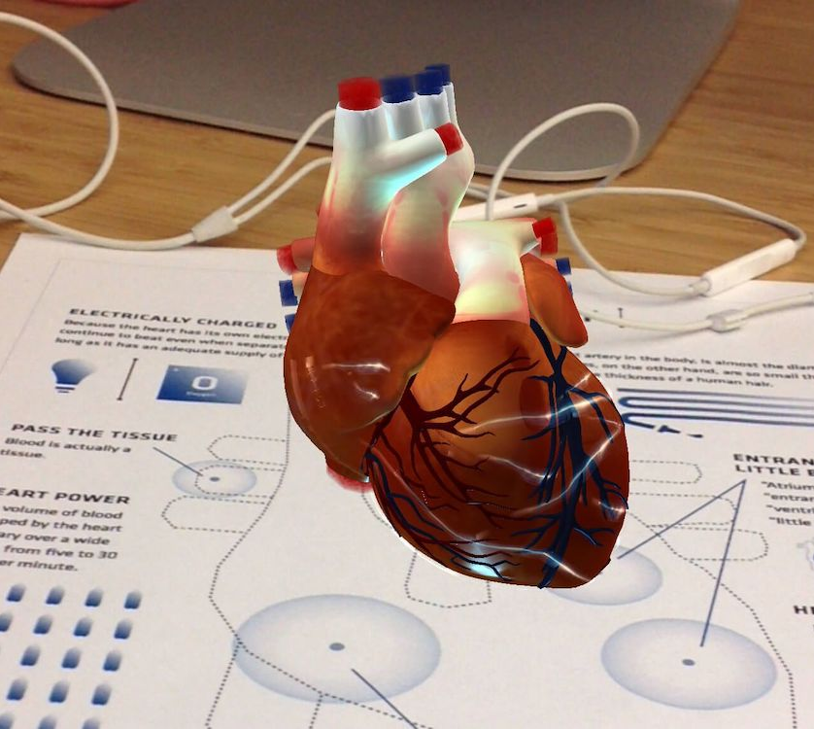
AR
18 Smit Kalathiya
3 6 Siddhi Raut
4 6 Yash Thakkar
Project Guide: Ms. Neha Gharat

Slide 3


Introduction
1) Augmented reality in education can serve a number of purposes. It helps the students easily acquire, process, and remember the information.
2) It is also not limited to a single age group or level of education, and can be used equally well in all levels of schooling and even at work.
3) In this project we will be building Augmented Reality based educational app using flutter. Flutter is a free and open-source mobile UI framework created by Google.
4) In a few words, we can use one programming language and one codebase to create two different apps (for iOS and Android).
Explore

Slide 4
Literature review :
Sr no. | Paper | Contex | Author
1 | Augmented Reality for Education; AR Children’s Book | AR book is an is close to mixed reality, that provides children with the visualization and sound of actual 3D models of fruits and the figures of all the letters (both English and Bengali). Tools used are AR-Vuforia SDK, Unity Game Engine, C# and blender. | Mohammad Fahim, Sudipta Barman, A K M Bahalul Haque
2 | Industrial Use Cases for Augmented Reality Application | The objective behind the realization of the use cases is the investigation of the AR application in the industry and its capability as digital transformation technology along the product lifecycle. | Dr.Ing. Fahmi Bellalouna
3 | Smart learning based on augmented reality with android platform and its applicability | In this system, live feed camera image (i.e., 2D image on paper) is captured by the camera, called Tracker image. The next step is the Pattern Recognition phase, here the tracker image is processed with the help of Image processing model to identify Patten behind 2D image and connect that recognized Patten with appropriate 3D object. | Yogita Bahuguna , Aashish Verma , Kunal Raj

Slide 5



System requirements & Technology Used
01. System Requirements
Ram/Rom- 4 GB+
Devices- Mobile phone /
Tablet / ipad
OS- Android / iOS
02. Technology Used
Flutter
Dart
Firebase
Unity 3D

Slide 6


Problem Definition
It is a common and known problem of the modern day’s student that they are having issues in concentrating on books,blackboards or any type of handout that is used to gather information. It is true that some theories written in books are difficult to understand. When we talk about the physical education that required the physical presence and the components, this type of training is either costly and also they are difficult for most and required lots of transport cost. It promotes lack of motivation and disinterest on the part of the student body which generates distraction and boredom on students.

Slide 7


Proposed Approach
AR is found to be very effective in the field of teaching
AR build the interest of students
AR get students excited about academic
Decided to develop Flutter based an application which can improve today education system
Teachers can enhance classroom experiences

Slide 8

References
[1]. Mohammad Fahim Hossain, Sudipta Barman, ’’ Augmented Reality for Education; AR Children’s Book” 2019
[2]. Dr.Ing. Fahmi Bellalouna, “Industrial Use Cases for Augmented Reality
Application” 2021
[3]. Yogita Bahuguna , Aashish Verma , Kunal Raj, “Smart learning based on augmented reality with android platform and its applicability”,2018
[4]. Developer Ajit, “Flutter Tutorial(” https://youtube.com/playlist?list=PLl_dQHtSKOoC1-VlqoAIVMYbCncmGzO5e

Slide 9
Thank You

